Slide 1
Microsoft Project Server and Team Foundation Server, Better Together
Randy Pagels
Sr. Developer Technology Specialist
Microsoft Corporation
www.teamsystemcafe.net

Slide 2
What is the TFS and PS Integration Feature Pack?
Provides bi-directional data synchronization between TFS and PS by linking tasks and work items
Requires TFS 2010 and PS 2010/2007
Supported, Localized and Documented
Available to MSDN subscribers only

Slide 3


Connecting Two Disparate Worlds
Related but separate disciplines
Business Value
Identified
Business Value
Delivered
Governance
Project Portfolio
Management (PPM)
Application Development
PEOPLE
PROCESS
TOOLS

Slide 4







Project and Portfolio Management for SharePoint
Business Intelligence & Reporting
Demand Management
Portfolio Selection
Project Team Collaboration
Resource Management
Schedule Management
Synch to SharePoint
Sites
Composites
Communities
Insights
Content
Search

Slide 5
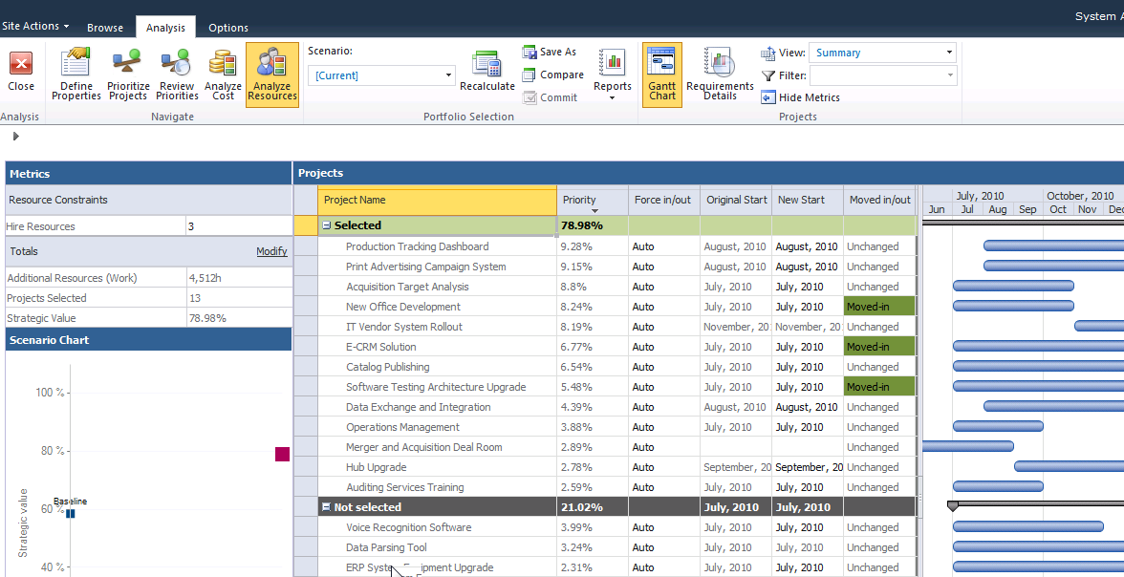

Portfolio Analysis
Sites
Composites
Communities
Insights
Content
Search

Slide 6
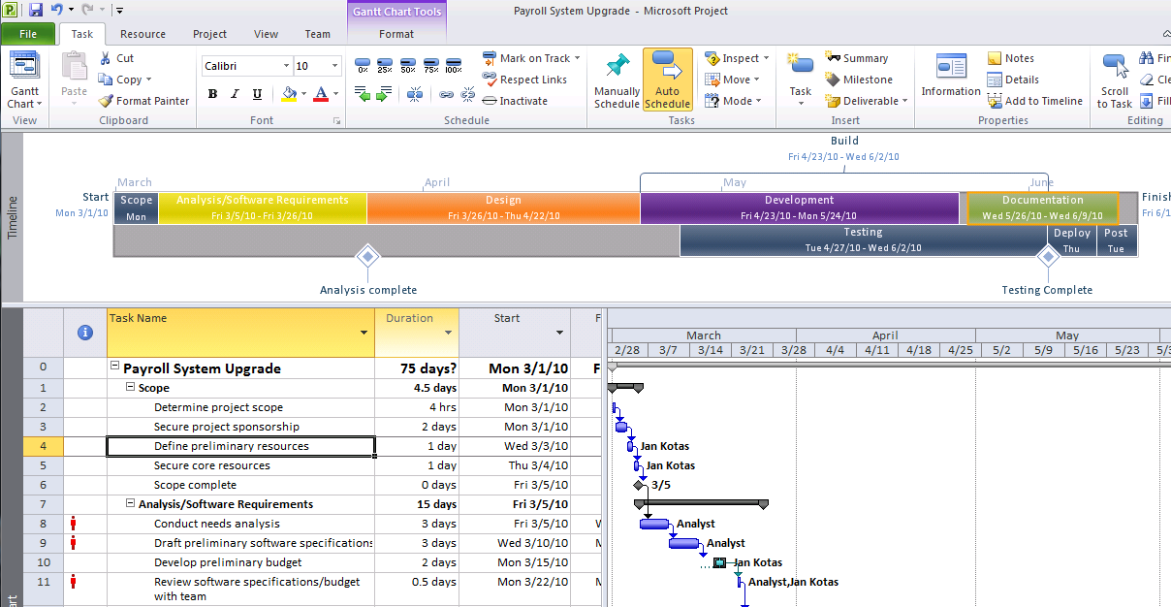
Schedule Management-Project Professional

Slide 7
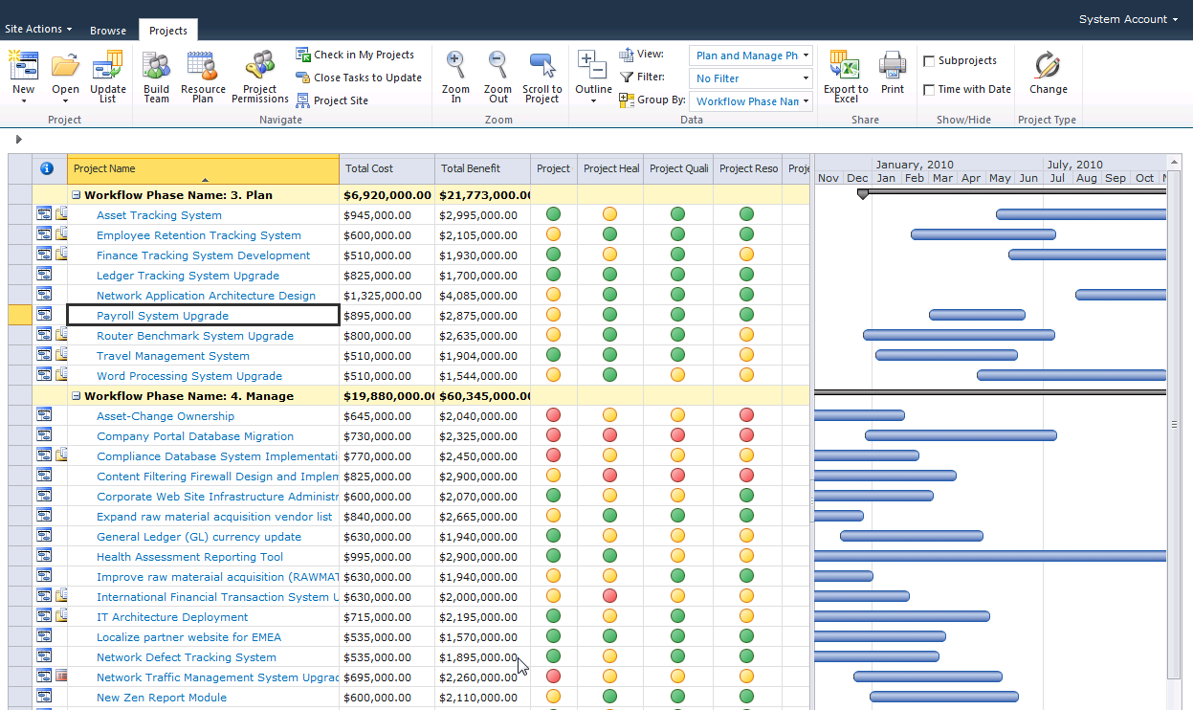
Schedule Management – Project Server

Slide 8
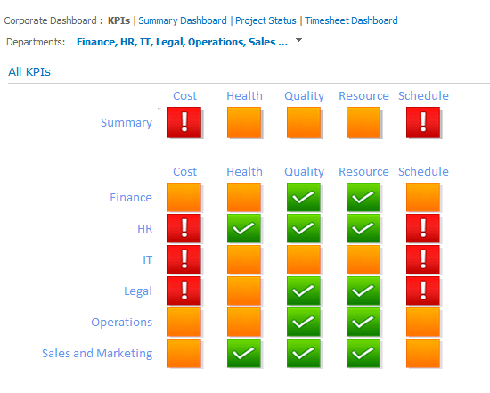
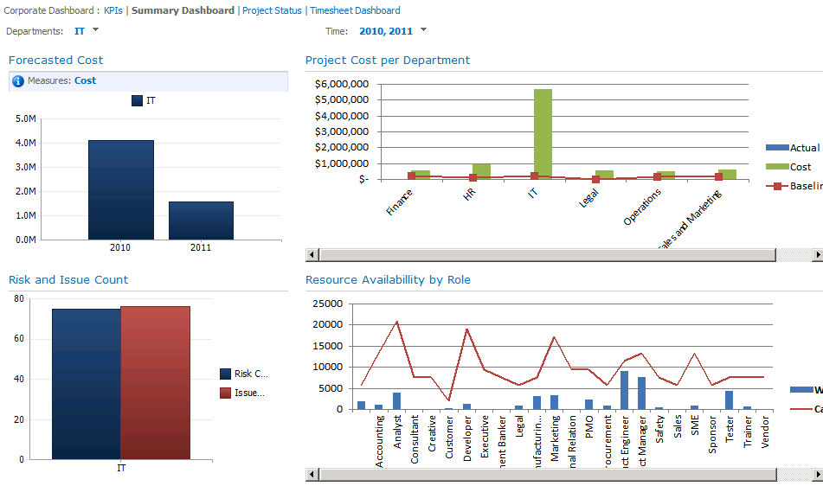
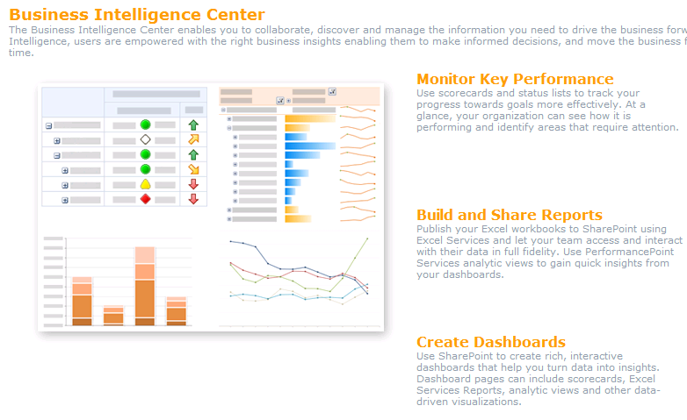
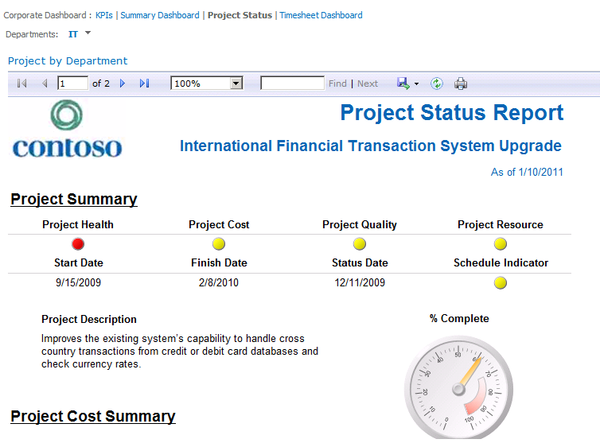
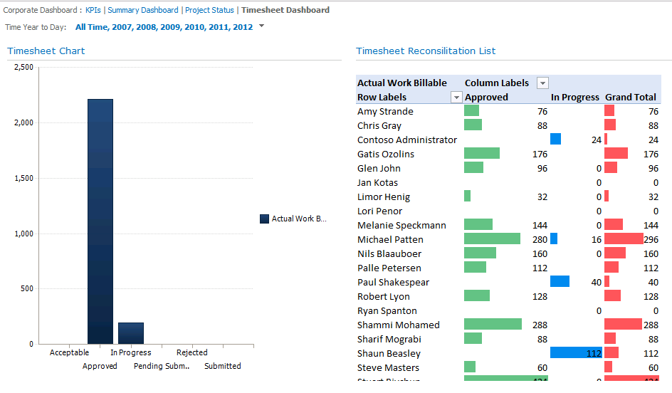
Business Intelligence and Reporting

Slide 9

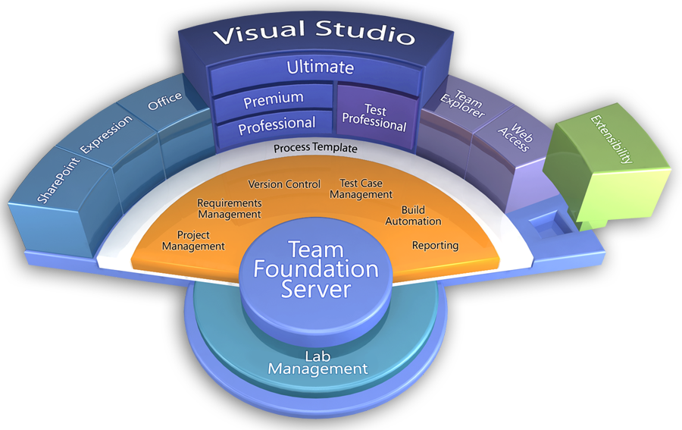


The Visual Studio Family

Slide 10
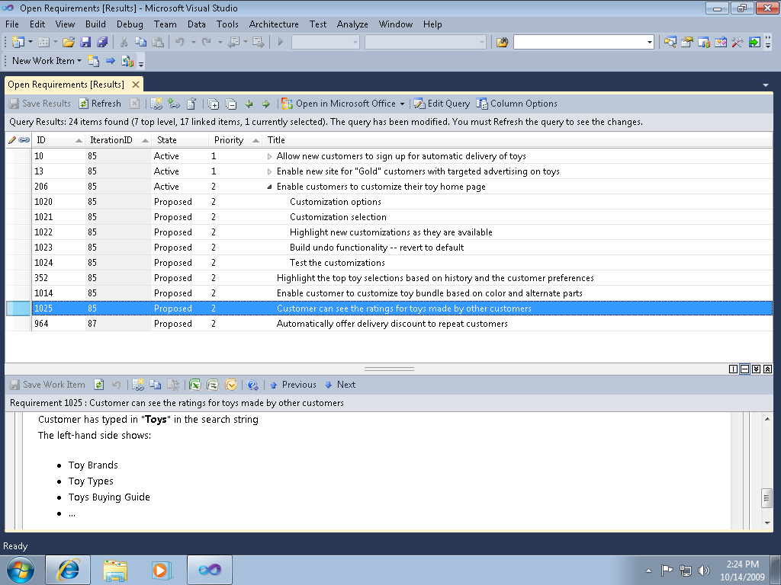

Slide 11
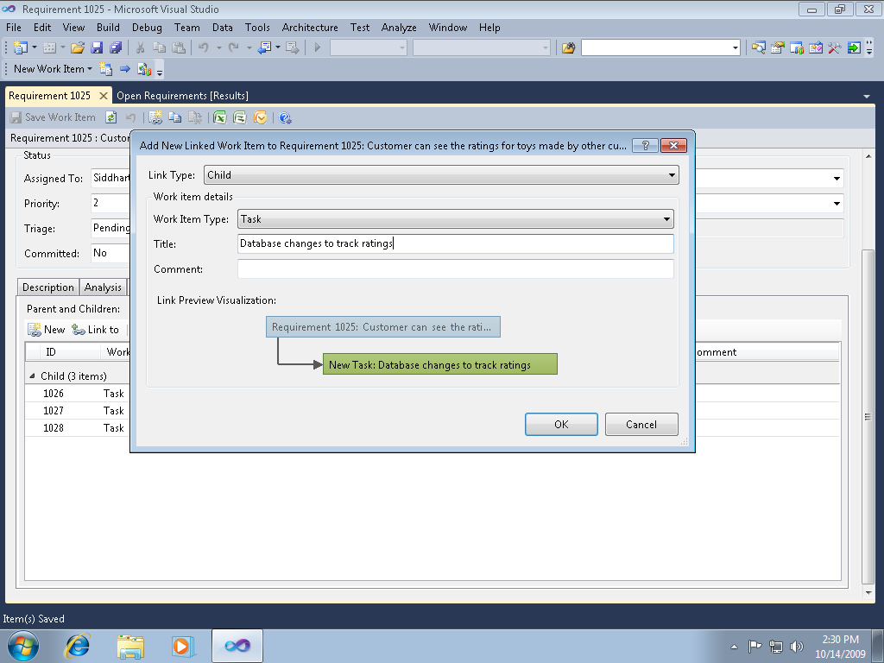

Slide 12
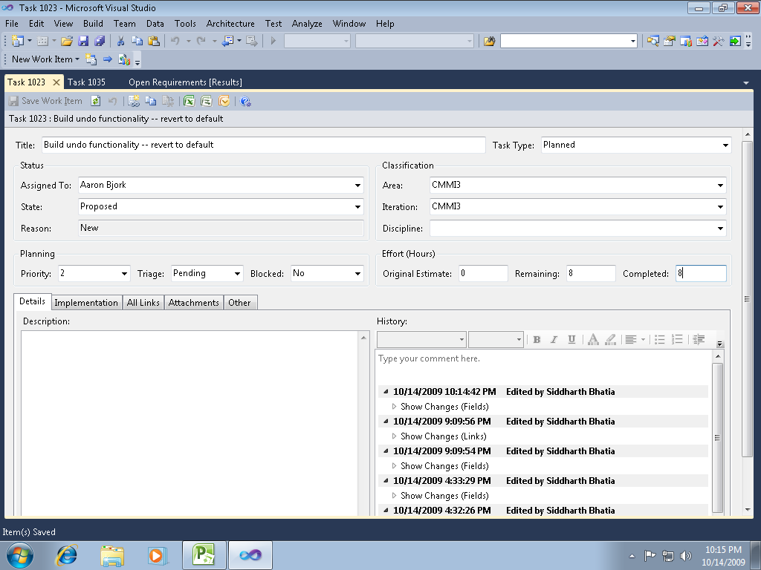

Slide 13
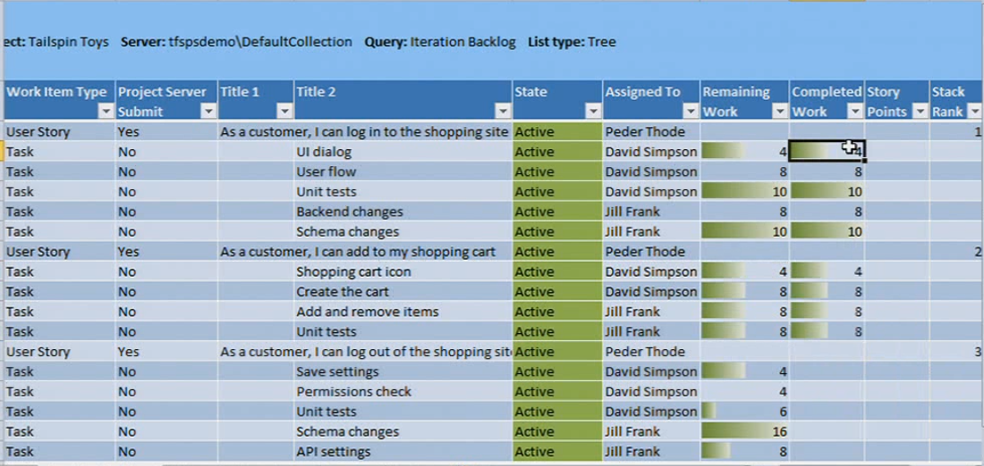
Excel breakdown

Slide 14
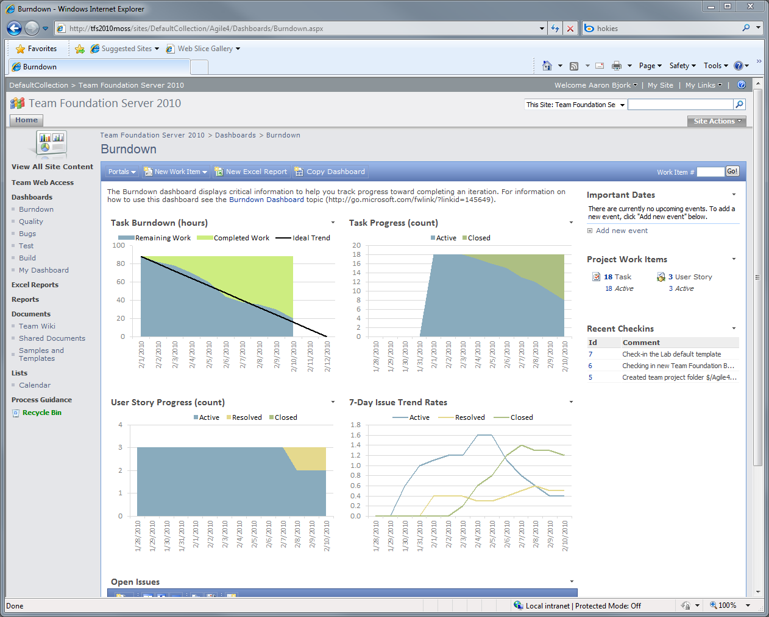

Slide 15
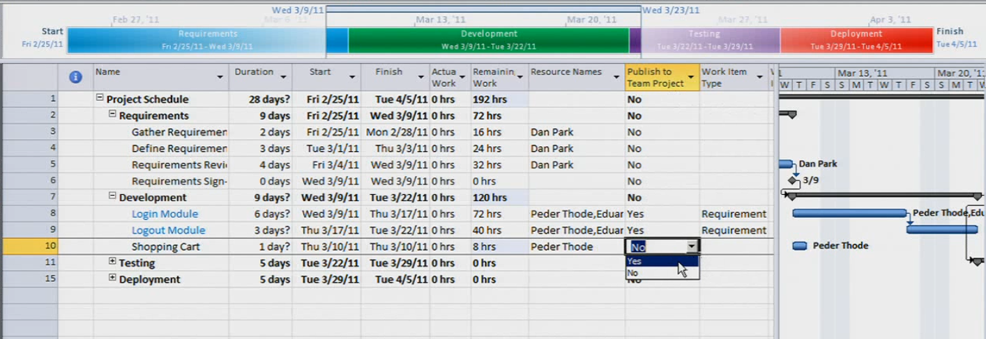
Microsoft Project Professional

Slide 16
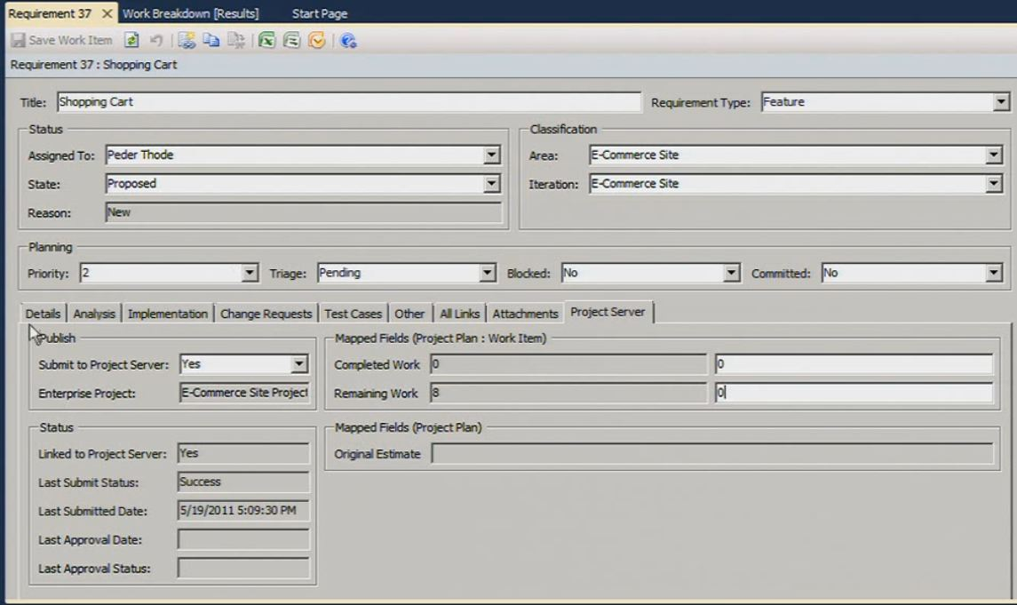

Slide 17
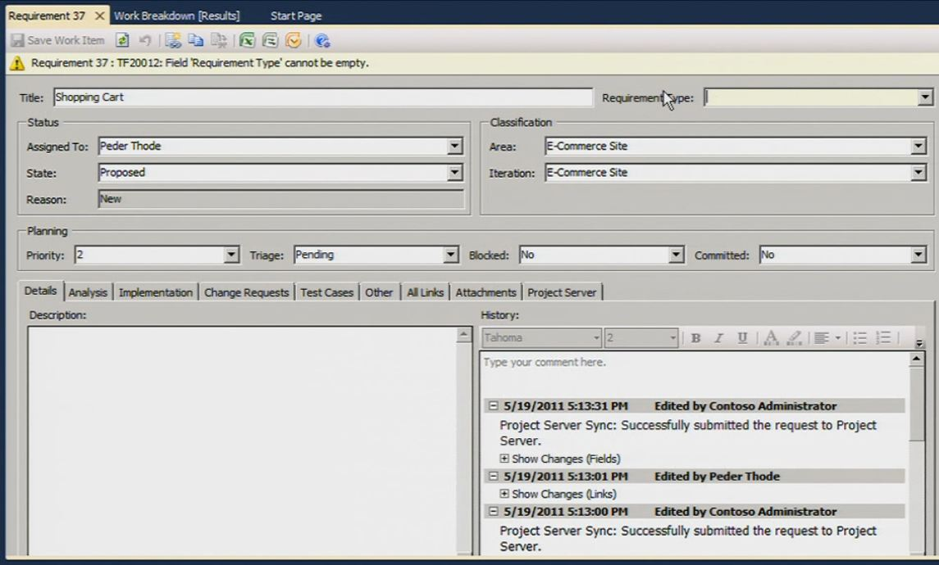

Slide 18
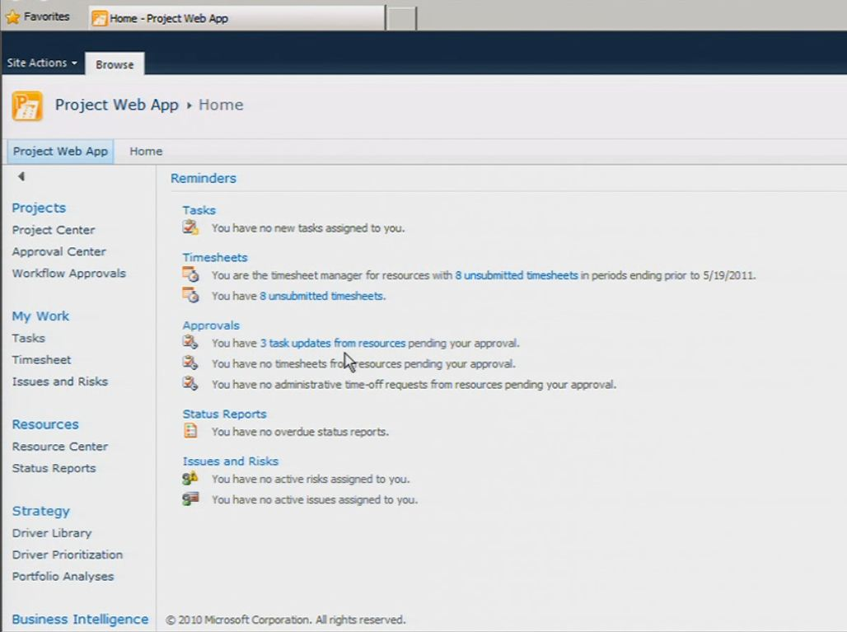
Project Web Portal

Slide 19








Visibility into an Agile Team
Agile Team
Daily Scrum
Project Management Office

Slide 20
Real-time Project Status for the PMO
Project Management Office
Development Team

Slide 21

Topology & Architecture – Three Steps
+ Service Pack 1
TFS 2010 and Project Server
Integration Feature Pack
1
2
+ Service Pack 1
3

Slide 22
Configuration in Six Steps
Grant Admin permissions
Register PWA Instance
Map PWA to a Team Project Collection
Upload default field mappings
Associate an Enterprise Project Plan with a Team Project
Add TFS Users to Project Server Enterprise Resource Pool
Grant Administrative Permissions
Register PWA Instance
Map PWA to Team Project Collection
Upload/Define Field Mappings for Integration
Associate Enterprise Project with TFS Team Project
Add TFS Users to Project Server Enterprise Resource Pool

Slide 23
Field Mapping: Default Mapping
Project Server | Team Foundation Server
Task Name | Title
Resource Names | Assigned To
Remaining Work | Remaining Work
Actual Work | Completed Work
Baseline Work | Original Estimate
Start | Start Date
Finish | Finish Date
Work Item ID | ID

Slide 24
Field Mapping: Concepts
Fields
TFS Field (Examples: Area Path, State, Assigned To)
Project Server Field (Examples: Resource Names, Project Area)
TFS Mirror Field: Stores the Project Server field value
Rules
Directionality: Two-way or One-way
  Two-way: Title
  One way from Project Server to TFS: Baseline Work
  One way from TFS to Project Server: Work Item ID
Who is the master?
  Set Project Server as the master: Title
  Keep “two sets of books”: Remaining Work and Completed Work
Control what is displayed in the Project Server tab

Slide 25
Customizing the Field Mapping
Determine additional fields
Download the field mapping file
Update the field mapping file
Upload the field mapping file
Determine Additional Fields to Map
Download Field Mapping File
Update Field Mapping File
Upload Field Mapping File
Customize Project Server Tab on WIT Form
(Optional)

Slide 26
Customer Value
TFS and Project Server Integration Feature Pack
Bridges the gap between Project Portfolio Management and Application Development
Enables developers and project managers to use the tools and processes of their choice
Allows teams to share project information transparently and provide management with insight into resource utilization, portfolio execution and alignment with strategic objectives

Slide 27


Customer Voices
“Integrating Team Foundation Server and Project Server I have traceability over my project and visibility over my resources and projects across my organization. I can extract the best from an ALM platform.”
Daniel Franco Abrahão de Oliveira, ALM Team Manager, TechResult
“When we talk with developers and testers, we can easily correlate that schedule to the details in Visual Studio Team Foundation Server 2010. As a result, everyone has better clarity. I have that level of confidence now because I’m supported by real data.”
Michael Lucas, Senior Program Management Lead, Microsoft
Microsoft Customer Case Studies

Slide 28
Demonstration Virtual Machine
http://go.microsoft.com/fwlink/?LinkID=196413
Require Windows Server 2008 with Hyper-V
Contains the following hands-on labs, which also function as demo scripts:
  Top-Down Planning of Business Requirements within an Enterprise Project using Team Foundation Server and Project Server
  Managing Project Details in an Enterprise Project Plan Mapped to a Team Project in Team Foundation Server
  Making Agile Team Progress Visible to the Project Management Office
  Managing Field Mappings for Integration of Team Foundation Server and Project Server

Slide 29
TFS and PS Integration Feature Pack resources
Solutions For Application Lifecycle Management: http://www.microsoft.com/visualstudio/en-us/solutions/management
White papers:
  Reconciling the Agile Team with Enterprise Project Management PDF - XPS
  Project and Work Management with Project Server 2010 and Team Foundation Server 2010: PDF - XPS
MSDN Product documentation: http://msdn.microsoft.com/library/gg455680.aspx
  MSDN Public Forums: Team Foundation Server and Project Server Integration

Slide 30
Resources
Demonstration videos on Channel 9:
  Real-time project status for the PMO
  Agile teams are no longer black holes
  Set the dial on your project plan details
  Resource visibility for the PMO
Technology Preview demo VM: http://go.microsoft.com/fwlink/?LinkID=196413
Provide us Feedback: http://social.msdn.microsoft.com/Forums/en-US/tfsprojectsrvint

Slide 31
Summary
Strengthens Microsoft’s Application Lifecycle Management Solution by bridging the gap between Project Portfolio Management and Application Development

Slide 32

© 2011 Microsoft Corporation. All rights reserved. Microsoft, Windows, Windows Vista and other product names are or may be registered trademarks and/or trademarks in the U.S. and/or other countries.
The information herein is for informational purposes only and represents the current view of Microsoft Corporation as of the date of this presentation. Because Microsoft must respond to changing market conditions, it should not be interpreted to be a commitment
on the part of Microsoft, and Microsoft cannot guarantee the accuracy of any information provided after the date of this presentation. MICROSOFT MAKES NO WARRANTIES, EXPRESS, IMPLIED OR STATUTORY, AS TO THE INFORMATION IN THIS PRESENTATION.

